Slide 1
10 steps to DevOps Part 6: Integrated testing / technical debt management
James Tramel
Developer Strategist
james.tramel@microsoft.com
Notes:
a

Slide 2
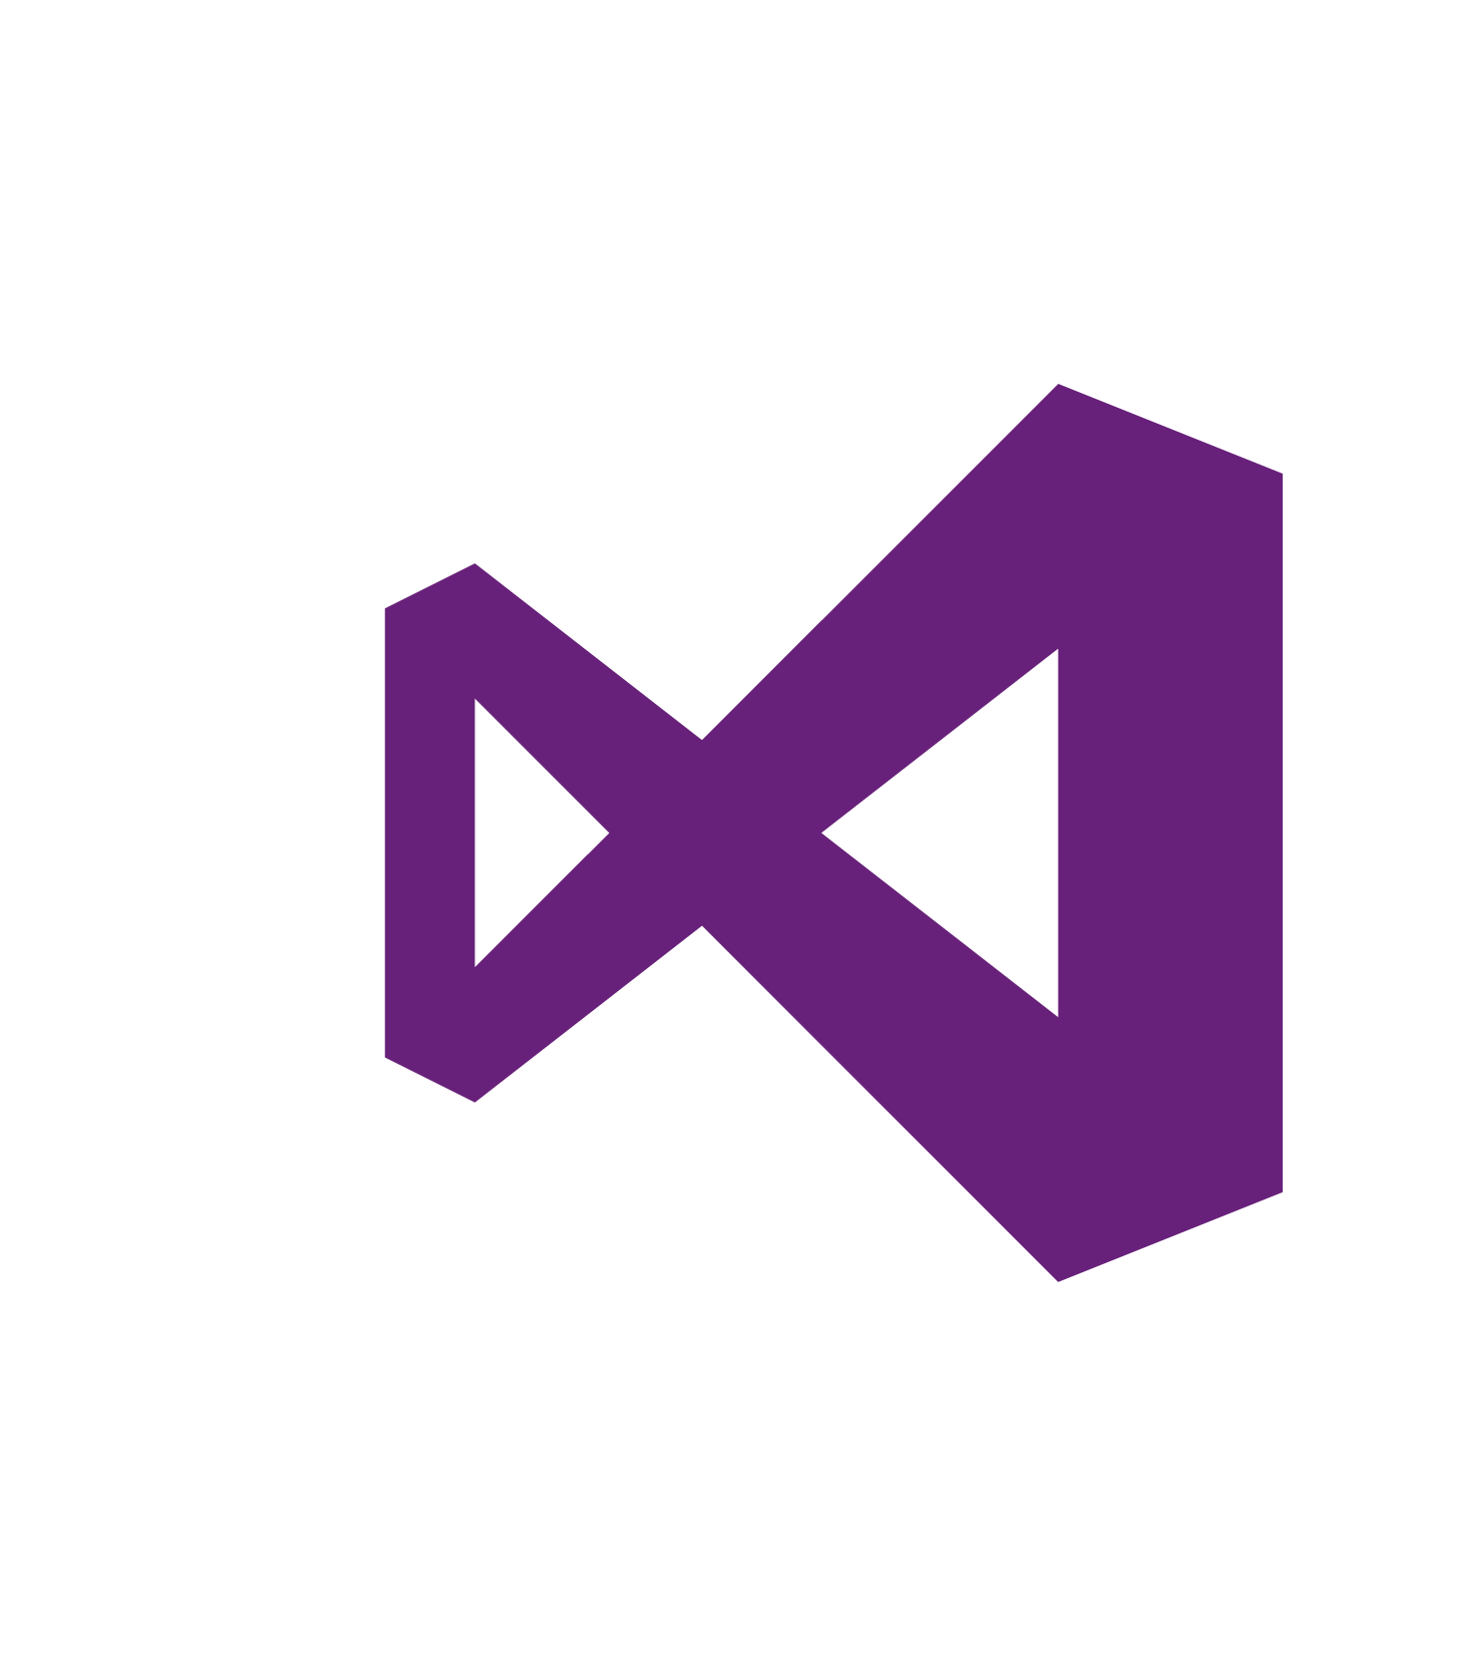
Every app Every Developer Every Platform
Visual Studio Online
Visual Studio
.NET
Notes:
The tool for everything. .net, sharepoint – web forms.
Mobile development - pokemon
Web Developer – notepad – web extensions
Javascript – typescript angular.
Talking Points
With the increase and diversity of devices there is an opportunity for developers to reach users where they are.
Also with the power of the cloud, infrastructure and capital expenditures no longer have to be a barrier to creating great applications.
Visual Studio 2015 bridges mobile and the cloud by being the first version built to target mobile-first and cloud-first development.

Slide 3
Software delivery challenges
?
Frustration
Delays
Lack of insights

Slide 4
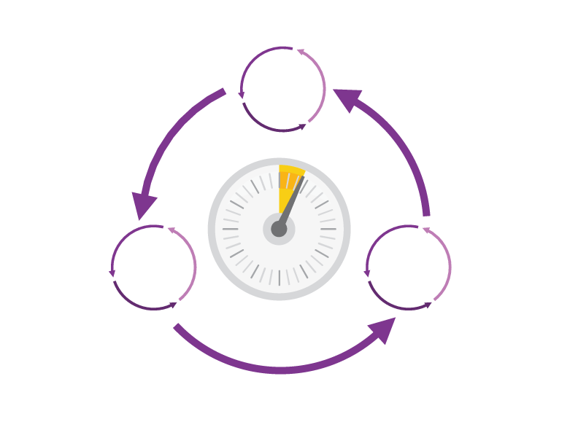
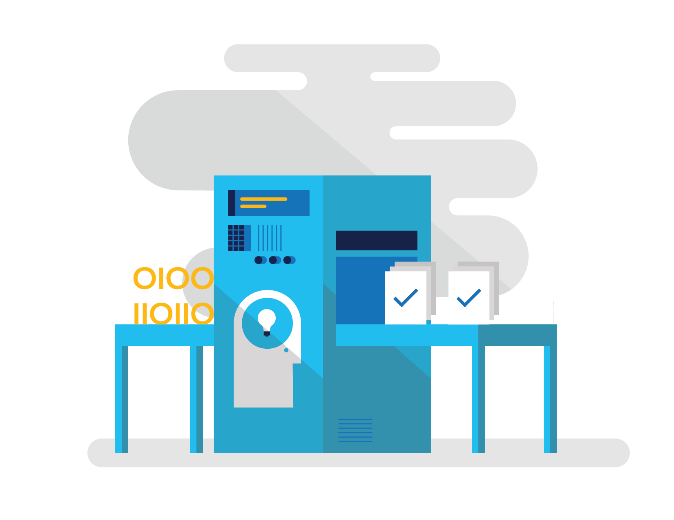
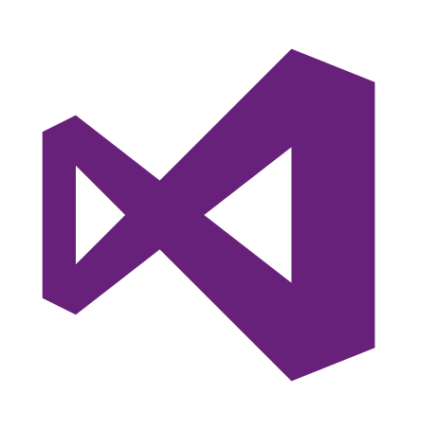
How Microsoft can help
Shorten Cycle Times
Optimize Resources
Improve Quality and Availablilty
Speed up and increase traceability of each release by empowering your development and operations teams with advanced collaboration and automation tools.
Efficiently manage environments using technologies that support self-service provisioning in a secure way, in line with your IT governance standards.
Capture rich telemetry on application performance and usage so that you can make better decisions on future investments and anticipate issues in production before they impact your service.
Visual Studio Team Services
Microsoft Azure
Visual Studio
Notes:
The Microsoft DevOps Solution provides a comprehensive set of software, cloud services, and other essential resources that help you deliver higher-quality software faster with less risk.
This solution is focused on addressing the most pressing challenges of the modern application lifecycle:
Shortening cycle times through advanced release management and automation tools
Optimizing resources and eliminating waste, and
Increasing quality and availability of your solutions

Slide 5






DevOps: the three components
DEV
OPS
1
People
2
Process
3
Products
Notes:
DevOps is the union of people, process, and products to enable continuous delivery of value to our end users.”\\
Focus today, from me, is process and products. Will focus on the how. The people is you. Be the change you want to see.

Slide 6
DevOps
1
4
Plan
Monitor + Learn
Development
Production
2
3
Develop + Test
Release

Slide 7




Visual Studio Enterprise – the tool for DevOps
Optimized for enterprise-class development
An integrated, end-to-end solution for teams of any size with demanding quality and scale needs. Take advantage of comprehensive tools and services for designing, building and managing complex enterprise solutions.
Greater productivity for enterprise application development and delivery
Plan, execute and monitor your entire quality effort, continuously
Manage complexity and close
the loop between Dev and Ops
Notes:
The tool for everything. .net, sharepoint – web forms.
Web Developer – notepad – web extensions
Javascript – typescript angular.

Slide 8
DevOps habits and practices
BACKLOG refined with LEARNING
MANAGED TECHNICAL DEBT
PRODUCTION FIRST MINDSET
INFRA-STRUCTURE is a FLEXIBLE RESOURCE
TEAM AUTONOMY & ENTERPRISE ALIGNMENT
EVIDENCE gathered in PRODUCTION
FLOW OF CUSTOMER VALUE

Slide 9
DevOps habits and practices
LEARN
Application Performance Management
Infrastructure as Code
Continuous Deployment
Release Management
Configuration Management
Automated Recovery
PLAN
Source Control
Stakeholder Feedback
Kanban
Bug Tracking
TEST
Application Performance Management
Usage Monitoring
Telemetry Collection Testing in Production
Stakeholder Feedback
APPROVE
Feature flags
Code Reviews
Automated Testing
Continuous Measurement
BACKLOG refined with LEARNING
MANAGED TECHNICAL DEBT
PRODUCTION FIRST MINDSET
INFRA-STRUCTURE is a FLEXIBLE RESOURCE
TEAM AUTONOMY & ENTERPRISE ALIGNMENT
EVIDENCE gathered in PRODUCTION
FLOW OF CUSTOMER VALUE
APP
Automated Testing
Code Review
Technical Debt
Continuous Integration
Continuous Deployment
Release Management
iNFRA
Automated Enviornment De Provision
Self Service Enviornment
Auotmated Recovery
MONITOR
Infrastructure as Code
Continuous Delivery
Release Management
Configuration Management
Automated Recovery
Testing in Production
Usage Monitoring
User Telemetry
Notes:
Automated Testing
Continuous Integration
Continuous Deployment
Release Management
Usage Monitoring
Telemetry Collection
Testing in Production
Application Performance Management
Infrastructure as Code
Continuous Delivery
Release Management
Change / Configuration Management
Automated Recovery
Load Testing
Avaialability Monitoring
Capactiy Management
Automated Enviornment De Provision
Self Service Enviornment
Auotmated Recovery (roll back / roll forward)
Stakeholder Feedback
Feature flags
Code Reviews / Technical Debt

Slide 10
Dev Ops Skill Katas
Modern Debugging
Automated Unit Testing and Architectural mapping
Work item / bug tracking / Continuous Test
Continuous deployment / integration
Infrastructure as code
Integrated testing / technical debt management
Continuous configuration / package management
Release management
Dev / test environments
Monitor and analyze
Notes:
Social club – intellitrace – works on anything .net
Taxation – intellitest and code maps
Sonar qube – vstsdemo – my shuttle 2 – myshuttle ci
https://sonarqube.com/, click rules
Package manager – parts unlimited – build – surreal engine – show feeds
Continuous integration – click on triggersin a build
Continuous deployment – parts unlimited
http://partsunlimited.azurewebsites.net/
Show deployment slots
Azurejut – dupont welcome -
Release – show Aramark azurejt
IAC – show github repo
Show create a new resource
https://github.com/Azure/azure-quickstart-templates
Dev test labs – en portal
Monitor and analytiz – so java portal or farkacam on my portal

Slide 11
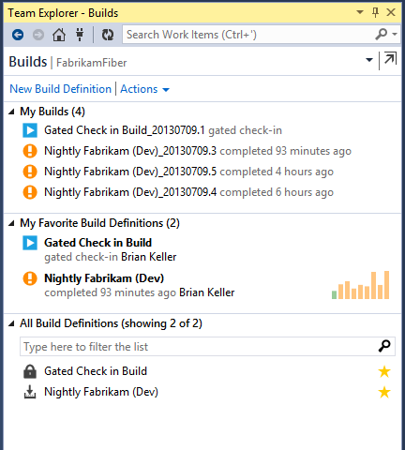
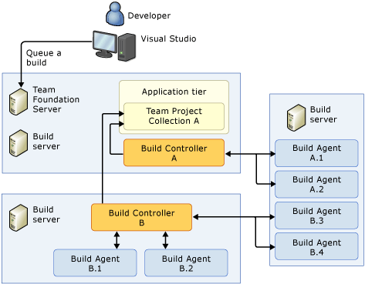
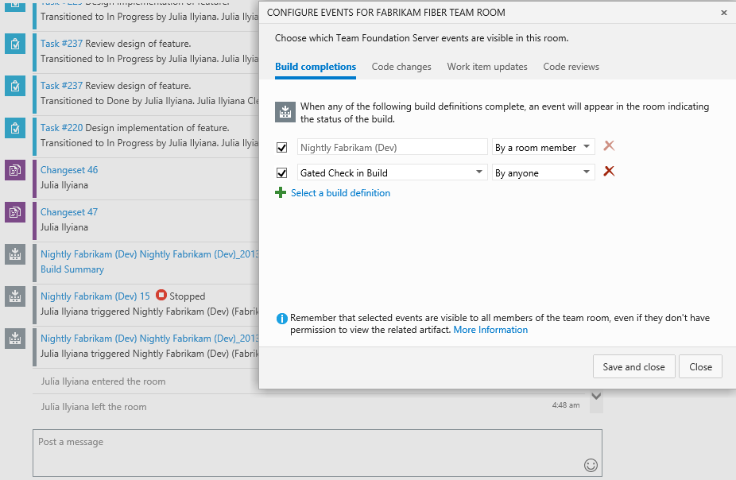
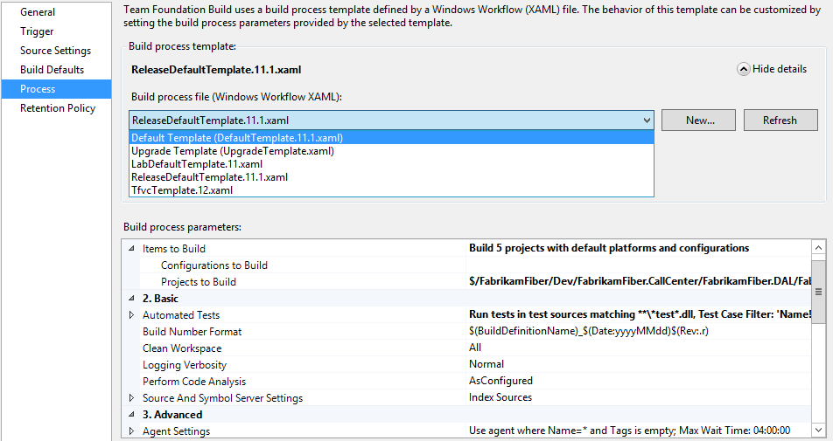
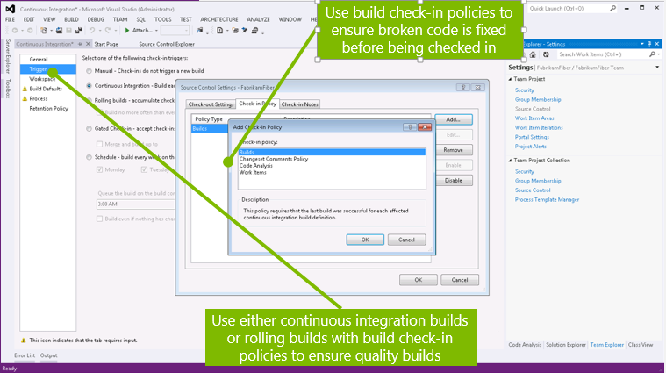
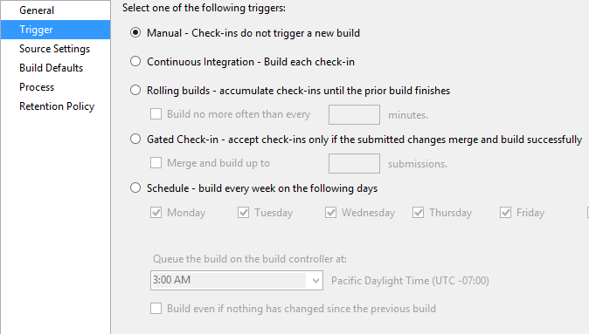
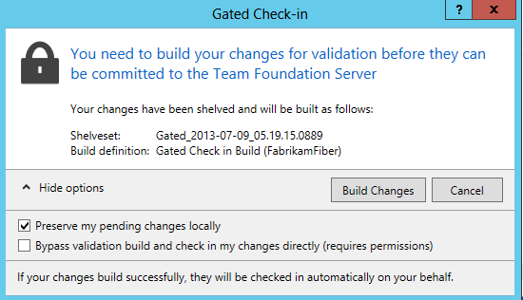
Build / Continuous Integration
Manage Builds
Build Triggers
Build Templates
Gated Check-In
Team Rooms
Notes:
With Team Foundation Build (TFBuild), you can create and manage build processes that automatically compile and test your applications, and perform other important functions. You can use your build system to support a strategy of continuous integration or put even more rigorous quality checks in place thatprevent bad quality code from “breaking the build.”
http://msdn.microsoft.com/en-us/library/ms181709.aspx

Slide 12
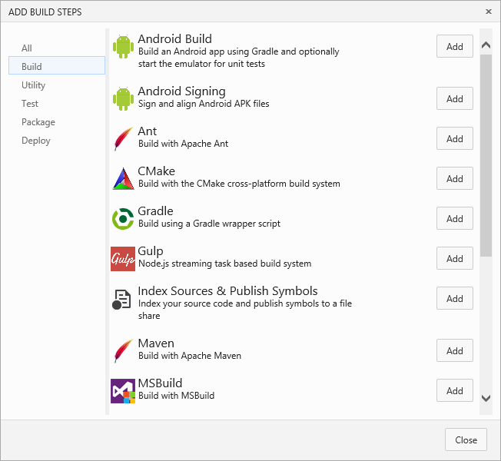
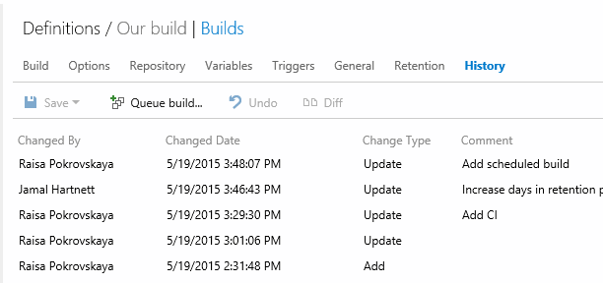
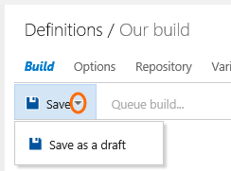
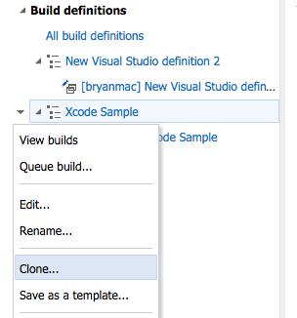
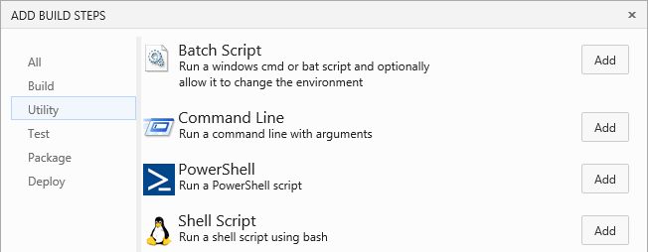
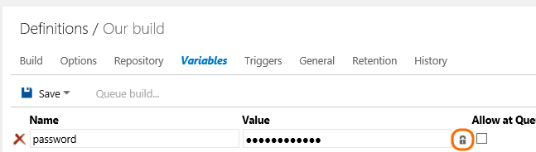
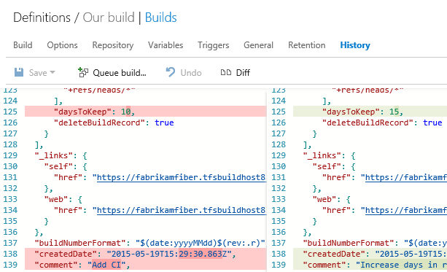
Team Build 2015:
Design
Your Way, Your Platform
Easy Customization
Change Control
Secret Variables
Drafts & Clones
Notes:
https://msdn.microsoft.com/Library/vs/alm/Build/feature-overview
No matter what tools you use. In whatever language you prefer. Team Foundation Build (TFBuild) 2015 builds your app, your way, for your platforms. Just open your web browser to tell us how you want it done.
Preview the next generation of Team Build
An early preview of the next generation of Team Build is included in this RC. What does this mean for your existing investments in Team Build? Moving forward from this release, the build automation features that shipped in TFS 2010, 2012, 2013 and Visual Studio Online based on the Windows Workflow engine will be referred to as XAML Builds. TFS 2015 and Visual Studio Online will continue to support the XAML Build templates and controllers. This means that when you upgrade your on-premises servers, everything will continue to work just as it does today. The two build systems run side by side and do not interfere with each other.
Here are some of the highlights of this new build system:
Easy customization
There is no need to ramp up on a platform specific build DSL. You can simply pick from a selection of build steps and set a few properties. You will have the ability to create your own tasks or import tasks from the community. These tasks will be instantly available for your users.
Code review policies can be used to set a minimum number of reviewers for pull requests, or even require specific users to review changes made to specific portions of your codebase.

Slide 13
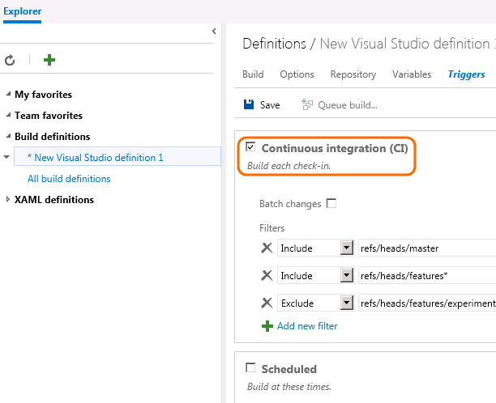
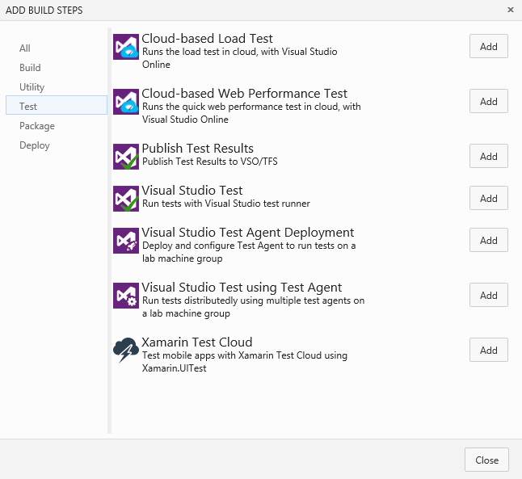
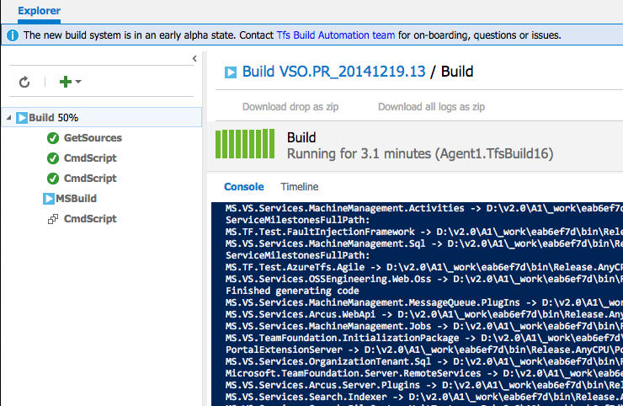

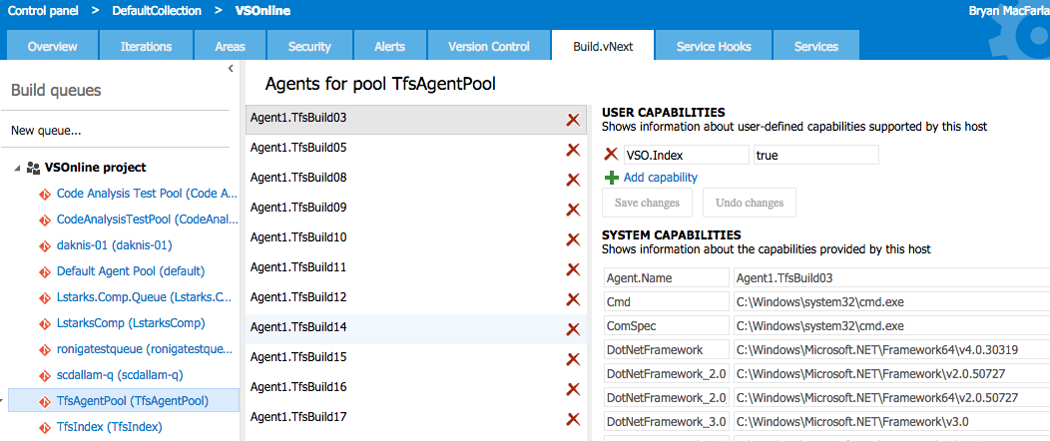
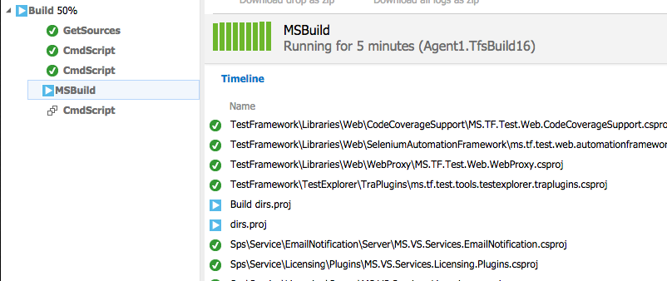
Team Build 2015:
Execute
Cross Platform Agents
Real Time Status
Agent Routing
Improved CI
Automated Testing
Notes:
https://msdn.microsoft.com/Library/vs/alm/Build/feature-overview
No matter what tools you use. In whatever language you prefer. Team Foundation Build (TFBuild) 2015 builds your app, your way, for your platforms. Just open your web browser to tell us how you want it done.
Preview the next generation of Team Build
An early preview of the next generation of Team Build is included in this RC. What does this mean for your existing investments in Team Build? Moving forward from this release, the build automation features that shipped in TFS 2010, 2012, 2013 and Visual Studio Online based on the Windows Workflow engine will be referred to as XAML Builds. TFS 2015 and Visual Studio Online will continue to support the XAML Build templates and controllers. This means that when you upgrade your on-premises servers, everything will continue to work just as it does today. The two build systems run side by side and do not interfere with each other.
Here are some of the highlights of this new build system:
Easy customization
There is no need to ramp up on a platform specific build DSL. You can simply pick from a selection of build steps and set a few properties. You will have the ability to create your own tasks or import tasks from the community. These tasks will be instantly available for your users.
Code review policies can be used to set a minimum number of reviewers for pull requests, or even require specific users to review changes made to specific portions of your codebase.

Slide 14
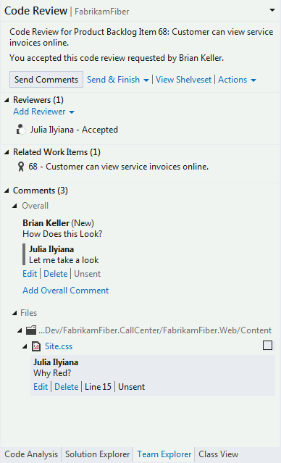
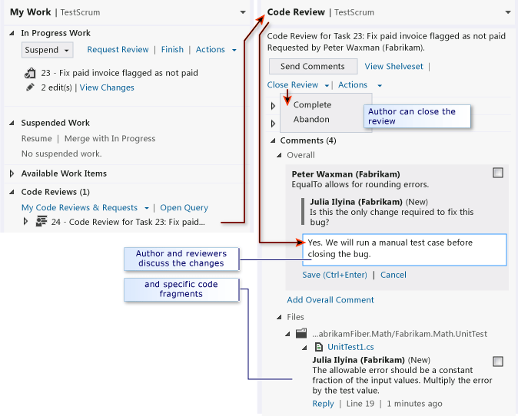
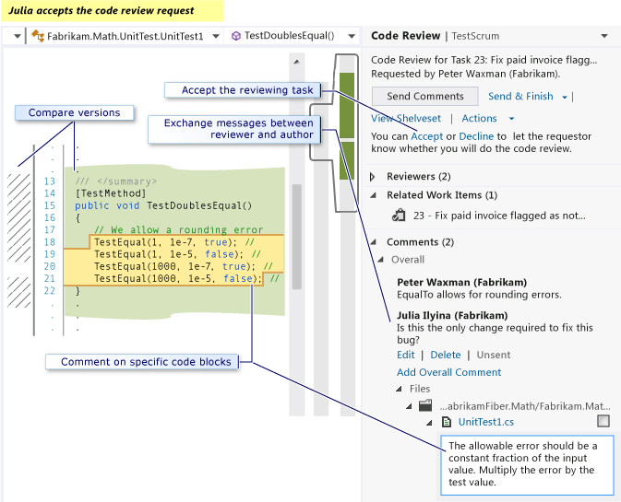
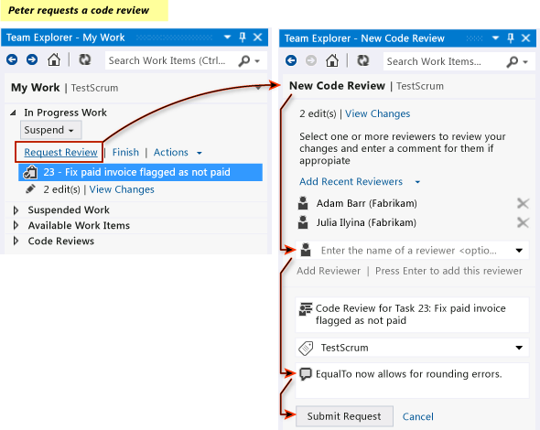
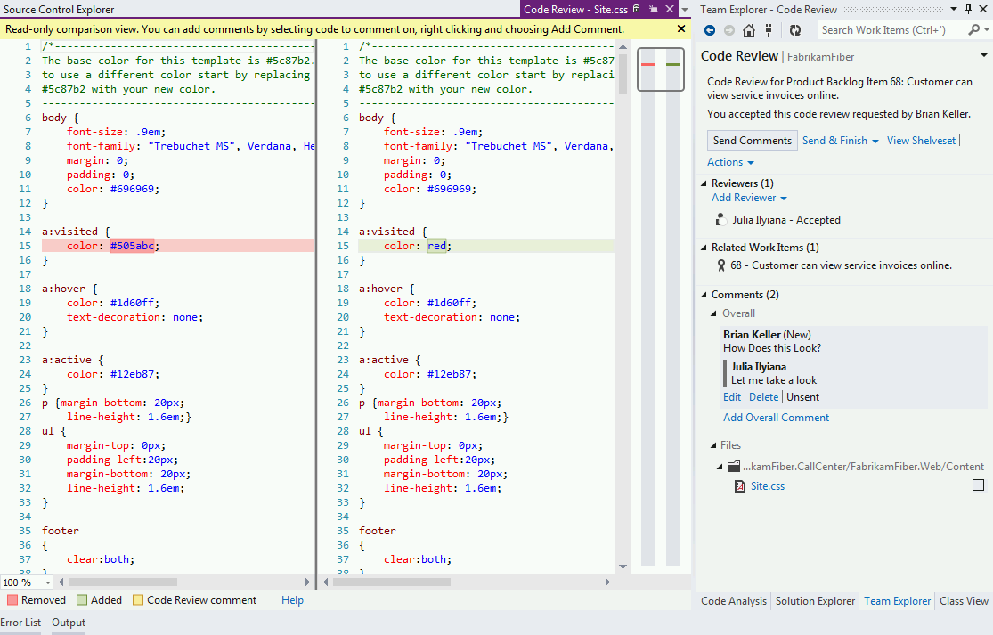
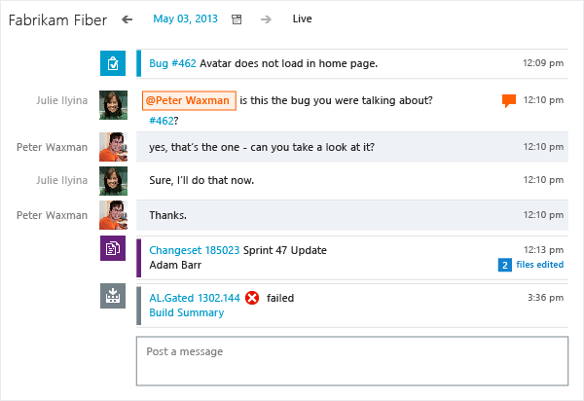
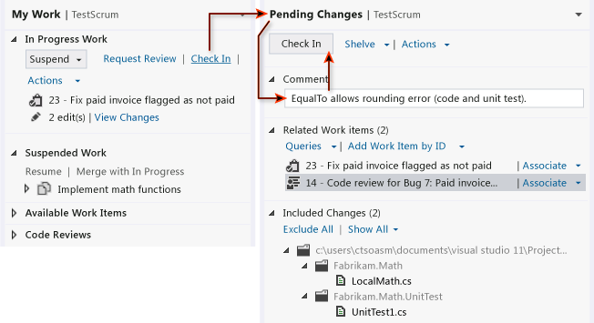
Integrated Code Review
Request Review
Accept Review
Collaborate
Associate w/ Changeset
Notes:
PREM Implement review processes to ensure quality.
Enhanced code-review workflows facilitate collaboration among your developers, providing a rich environment to review the code and propose changes.

Slide 15
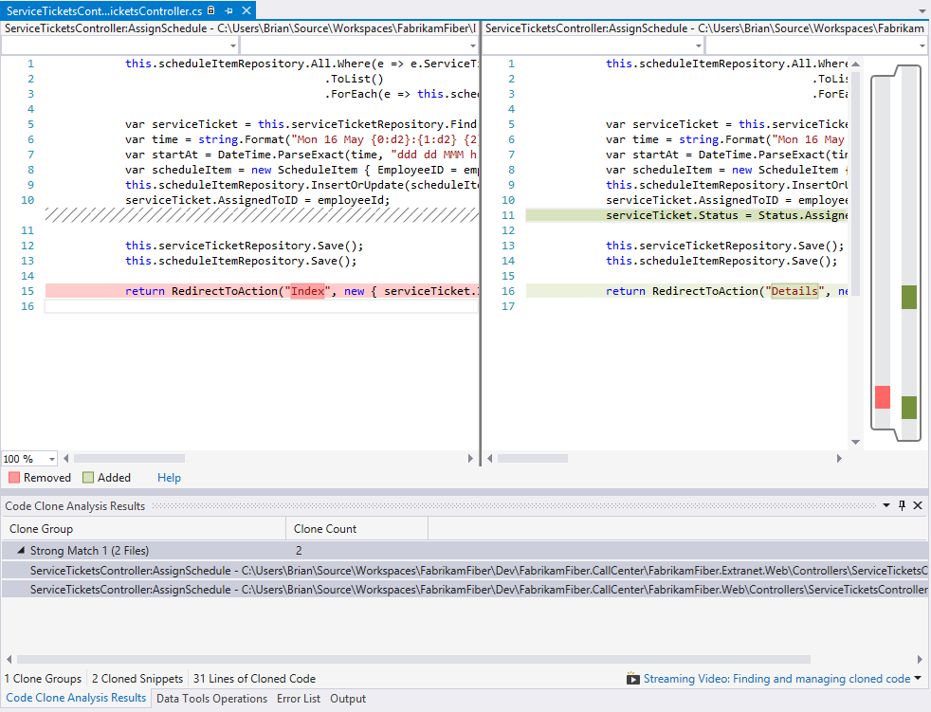
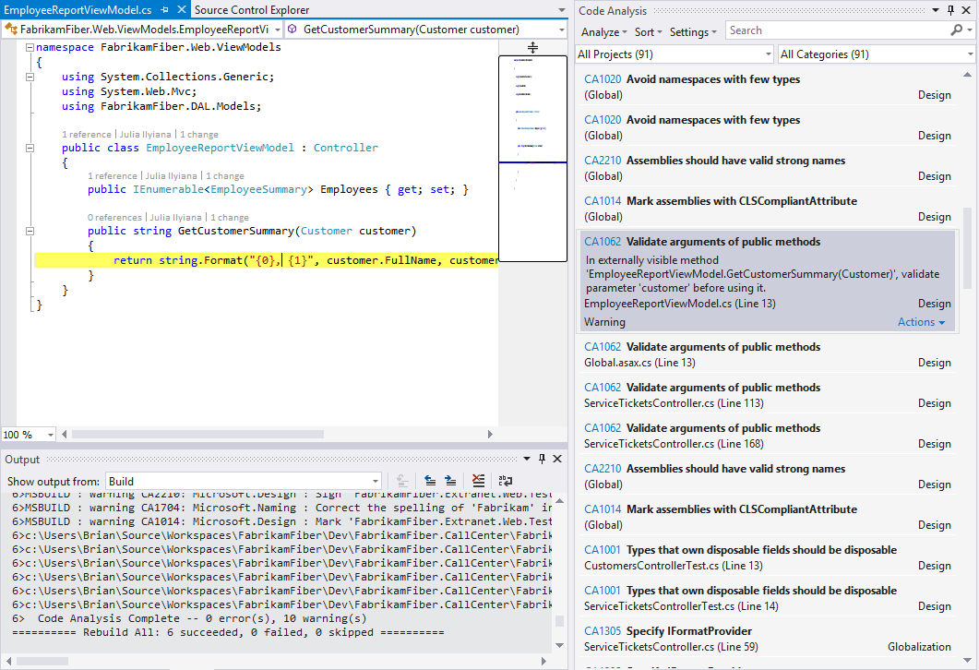
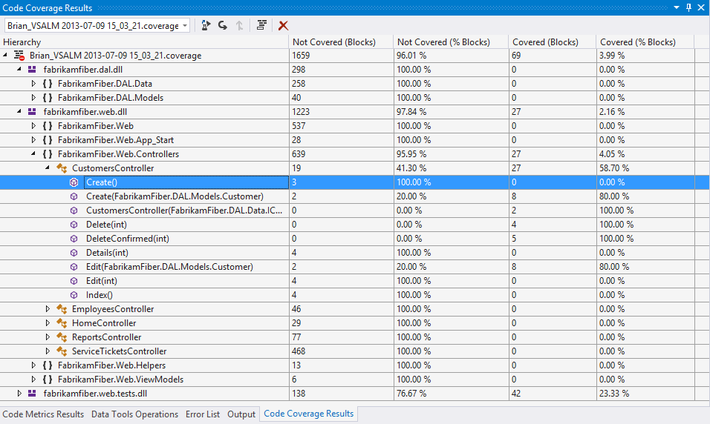
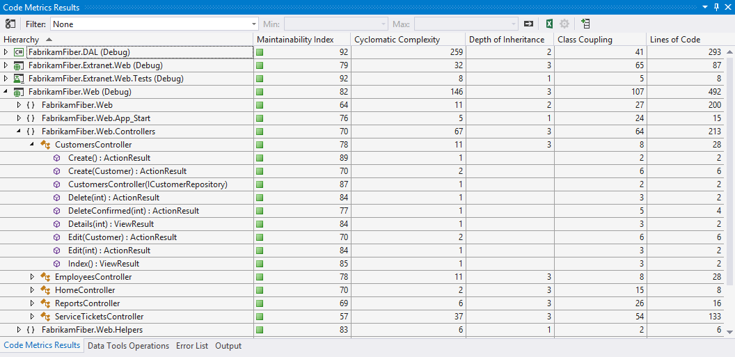
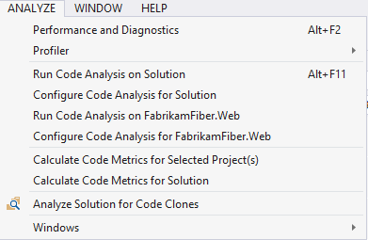
Code Analysis
Static Analysis
Code Metrics
Code Coverage
Code Clones
Improved SharePoint &
C++ Support
Notes:
Ensure high-quality code with built-in tools.
Help ensure best practices are met for different teams and providers by using static analysis, code metrics, code coverage, profiling, and code-clone detection, now with additional support for SharePoint and C++ development.
Code Analysis for Managed Code Overview
Visual Studio 2013
Other Versions
This topic has not yet been rated - Rate this topic
[This documentation is for preview only, and is subject to change in later releases. Blank topics are included as placeholders.]
Code analysis for managed code analyzes managed assemblies and reports information about the assemblies, such as violations of the programming and design rules set forth in the Microsoft .NET Framework Design Guidelines.
The analysis tool represents the checks it performs during an analysis as warning messages. Warning messages identify any relevant programming and design issues and, when it is possible, supply information about how to fix the problem.
IDE (integrated development environment) Integration
As a developer, you can run code analysis on your project automatically or you can run it manually.
To run code analysis each time that you build a project, you select Enable Code Analysis on Build (defines CODE_ANALYSIS constant) on the project's Property Page. For more information, see How to: Enable and Disable Automatic Code Analysis for Managed Code.
To run code analysis manually on a project, on the Analyze menu, click Run Code Analysis on ProjectName. For more information, see How to: Enable and Disable Automatic Code Analysis for Managed Code.
Rule Sets
Code analysis rules for managed code are grouped into rule sets. You can use one of the Microsoft standard rule sets, or you can create a custom rule set to fulfill a specific need. For more information, see Using Rule Sets to Group Code Analysis Rules.
In Source Suppression
Frequently, it is useful to indicate that a warning is non-applicable. This informs the developer, and other people who might review the code later, that a warning was investigated and then either suppressed or ignored.
In Source Suppression of warnings is implemented through custom attributes. To suppress a warning, add the attribute SuppressMessage to the source code as shown in the following example:
[System.Diagnosis.CodeAnalysis.SuppressMessage("Microsoft.Design", "CA1039:ListsAreStrongTyped")]
Public class MyClass
{
// code
}
For more information, see Suppress Warnings By Using the SuppressMessage Attribute.
Run code analysis as part of check-in policy
As an organization, you might want to require that all check-ins satisfy certain policies. In particular, you want to make sure that you follow these policies:
There were no build errors in code being checked in.
Code analysis was run as part of the most recent build.
You can accomplish this by specifying check-in policies. For more information, see Enhancing Code Quality with Team Project Check-in Policies.
Team Build Integration
You can use the integrated features of the build system to run the analysis tool as part of the build process. For more information, see Build the application.

